Slide 1

LIBRARY MANAGEMENT SYSTEM

Slide 2
OVERVIEW
This project demonstrates the implementation of a Library Management System using SQL.
It includes creating and managing tables, performing CRUD operations, and executing SQL queries.
The goal is to showcase skills in database design, manipulation, and querying.

Slide 3
OBJECTIVES
Set up the Library Management System Database: Create and populate the database with tables for branches, employees, members, books, issued status, and return status.
CRUD Operations: Perform Create, Read, Update, and Delete operations on the data.
CTAS (Create Table As Select): Utilize CTAS to create new tables based on query results.

Slide 4
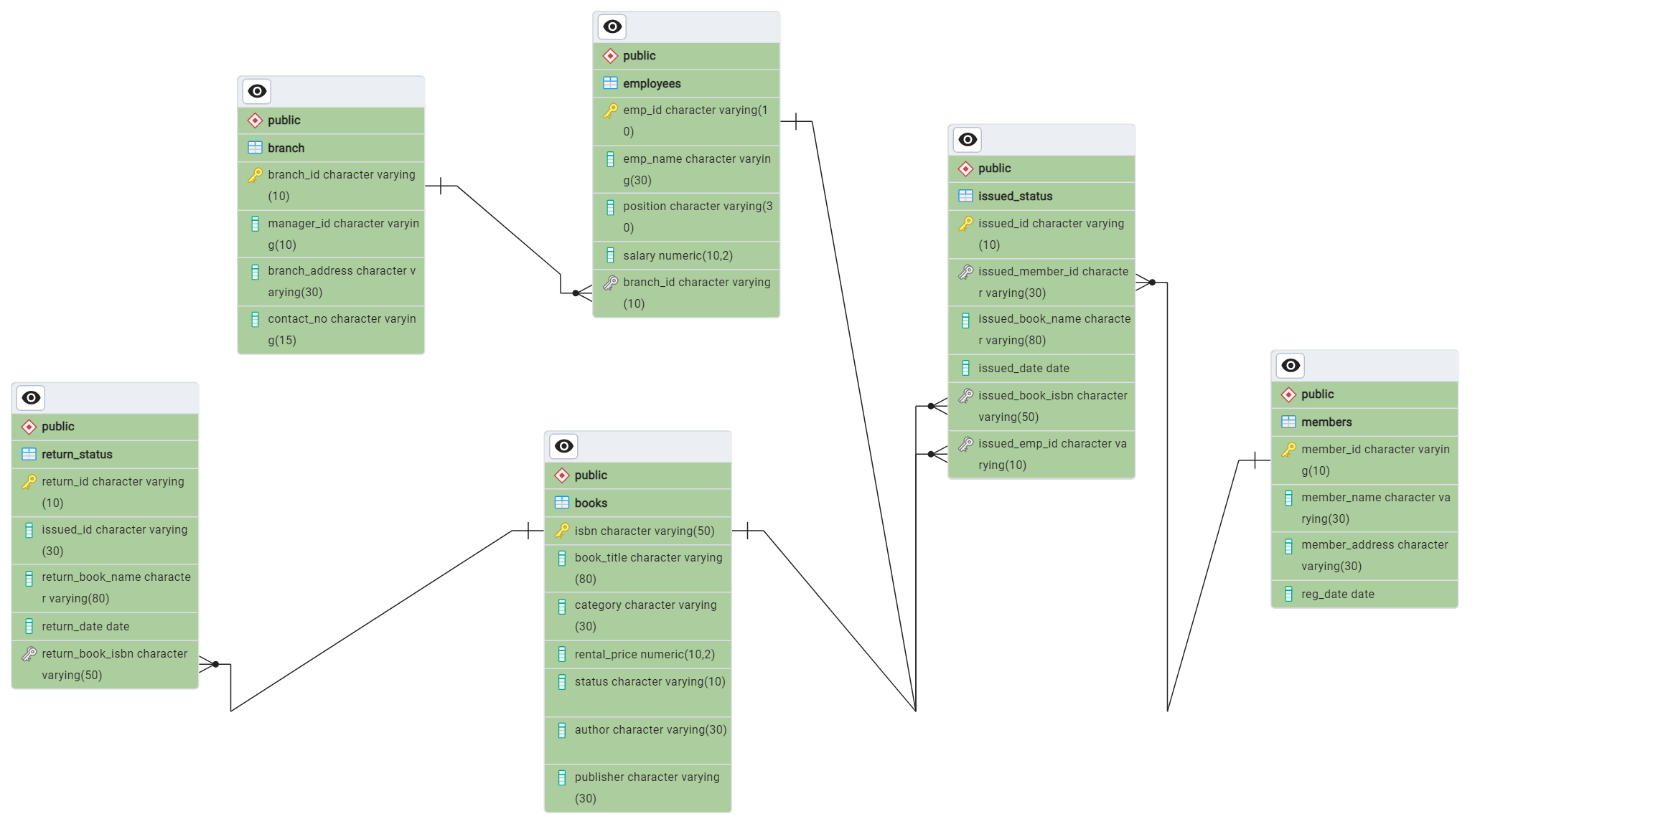

Slide 5
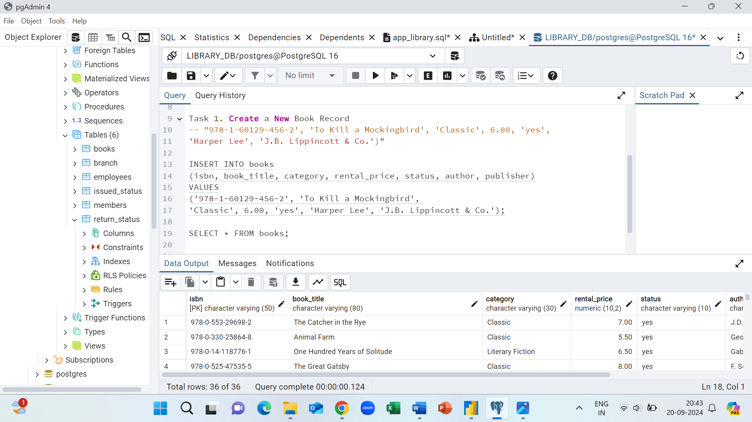
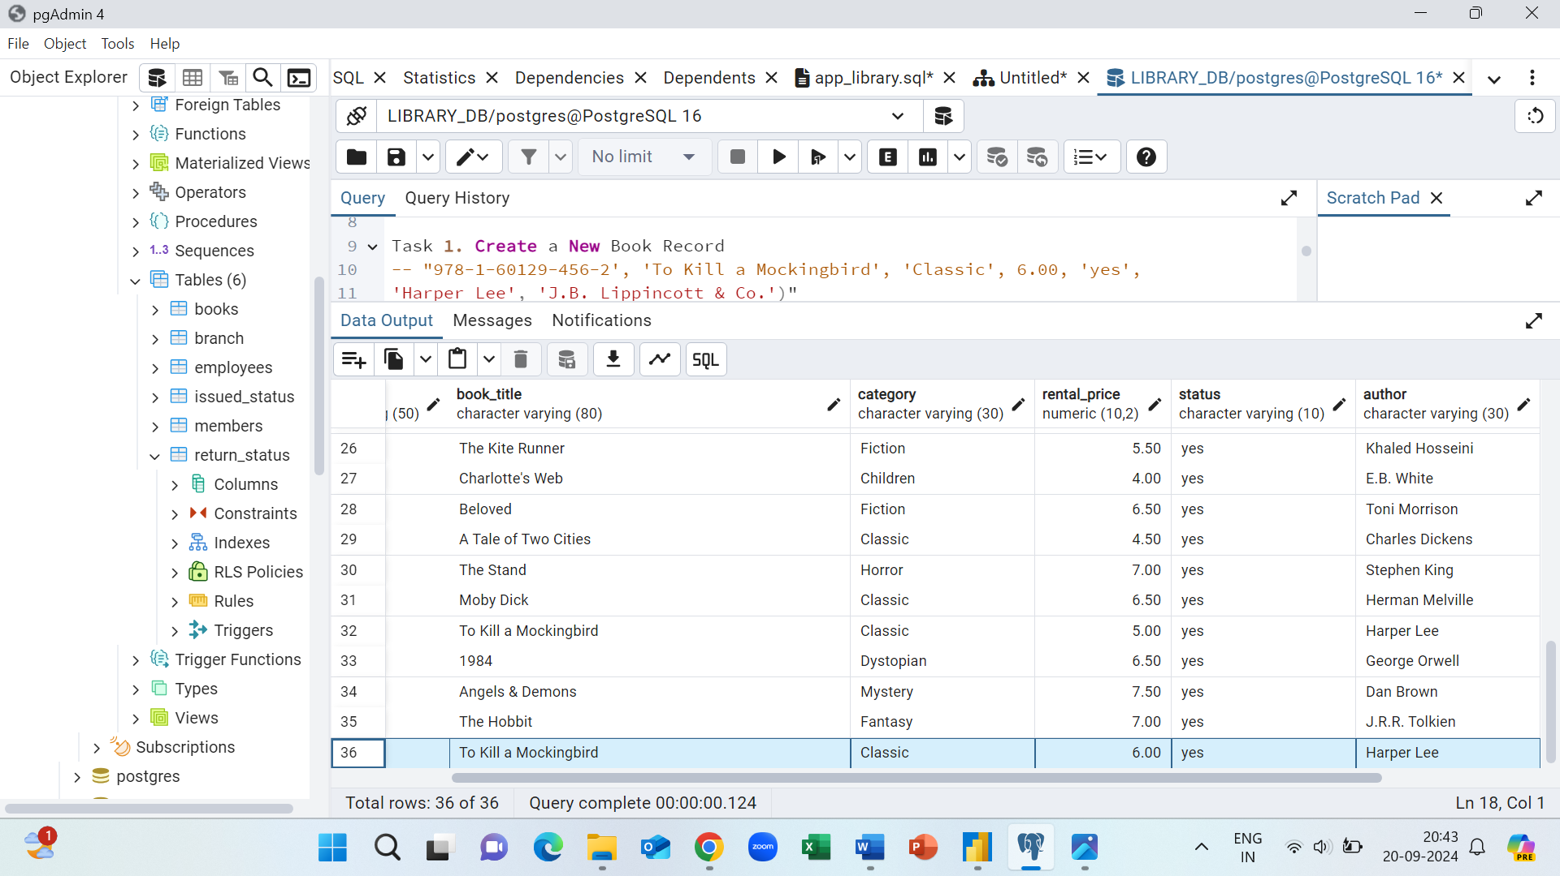
Task 1. Create a New Book Record -- "978-1-60129-456-2', 'To Kill a Mockingbird', 'Classic', 6.00, 'yes', 'Harper Lee', 'J.B. Lippincott & Co.')"

Slide 6
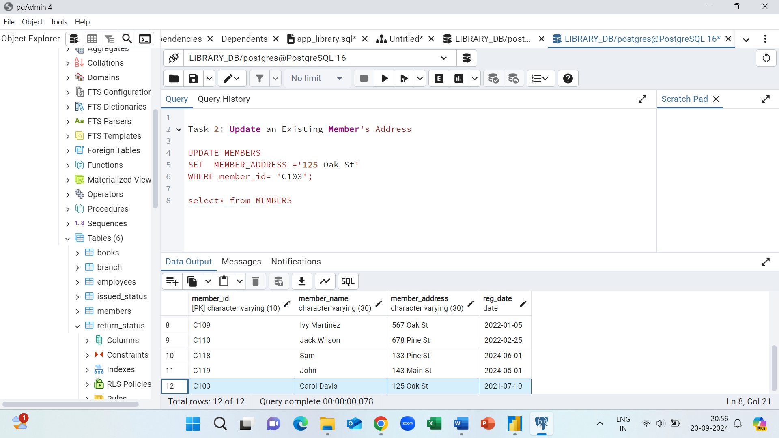
Task 2: Update an Existing Member's Address

Slide 7
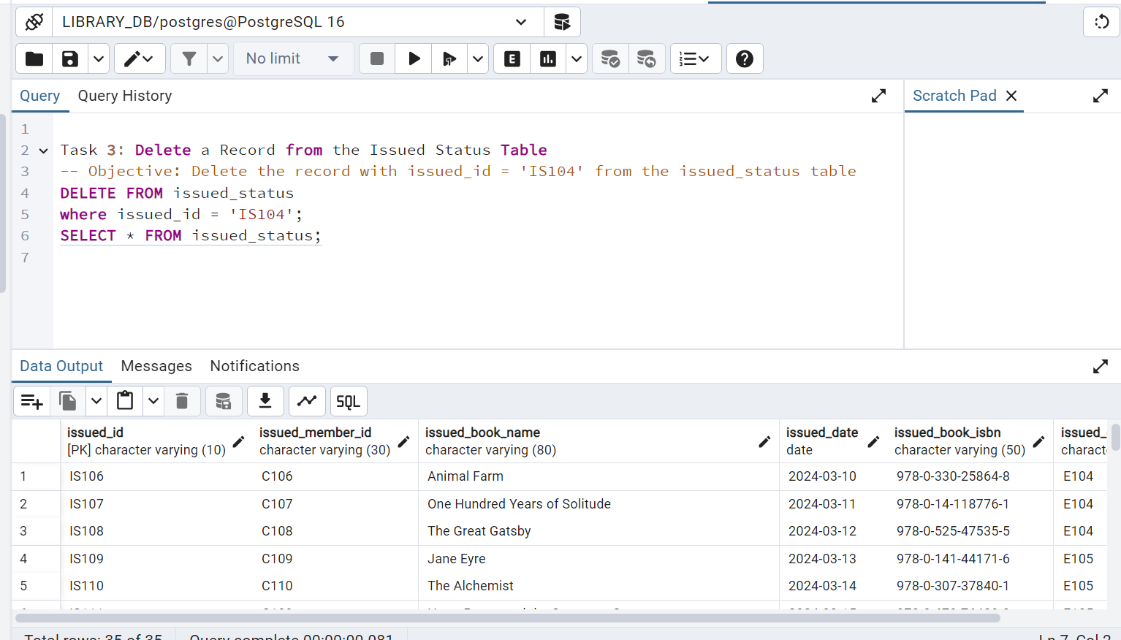
Task 3: Delete a Record from the Issued Status Table -- Objective: Delete the record with issued_id = 'IS121' from the issued_status table.

Slide 8
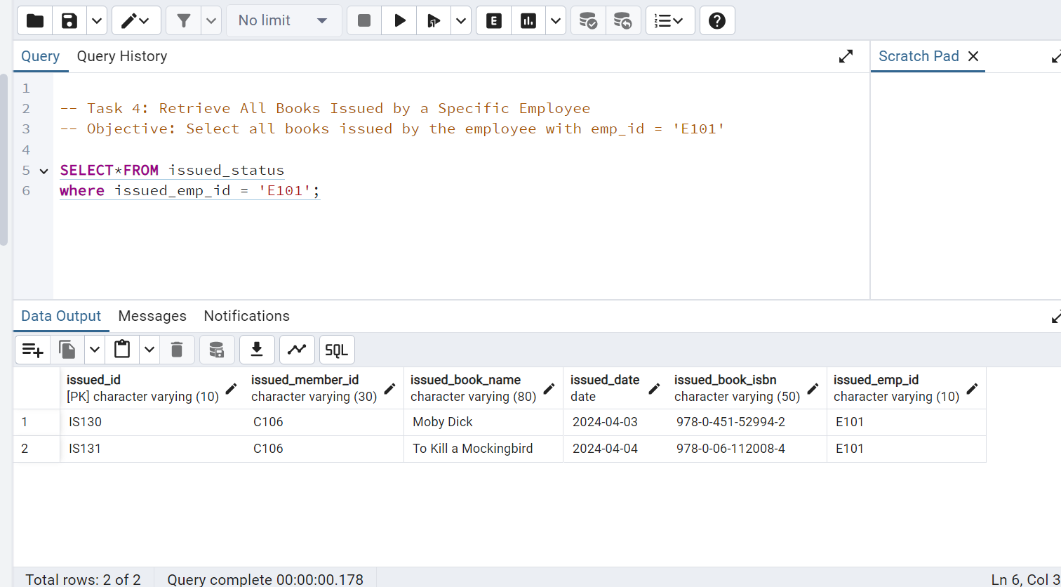
Task 4: Retrieve All Books Issued by a Specific Employee -- Objective: Select all books issued by the employee with emp_id = 'E101'.

Slide 9
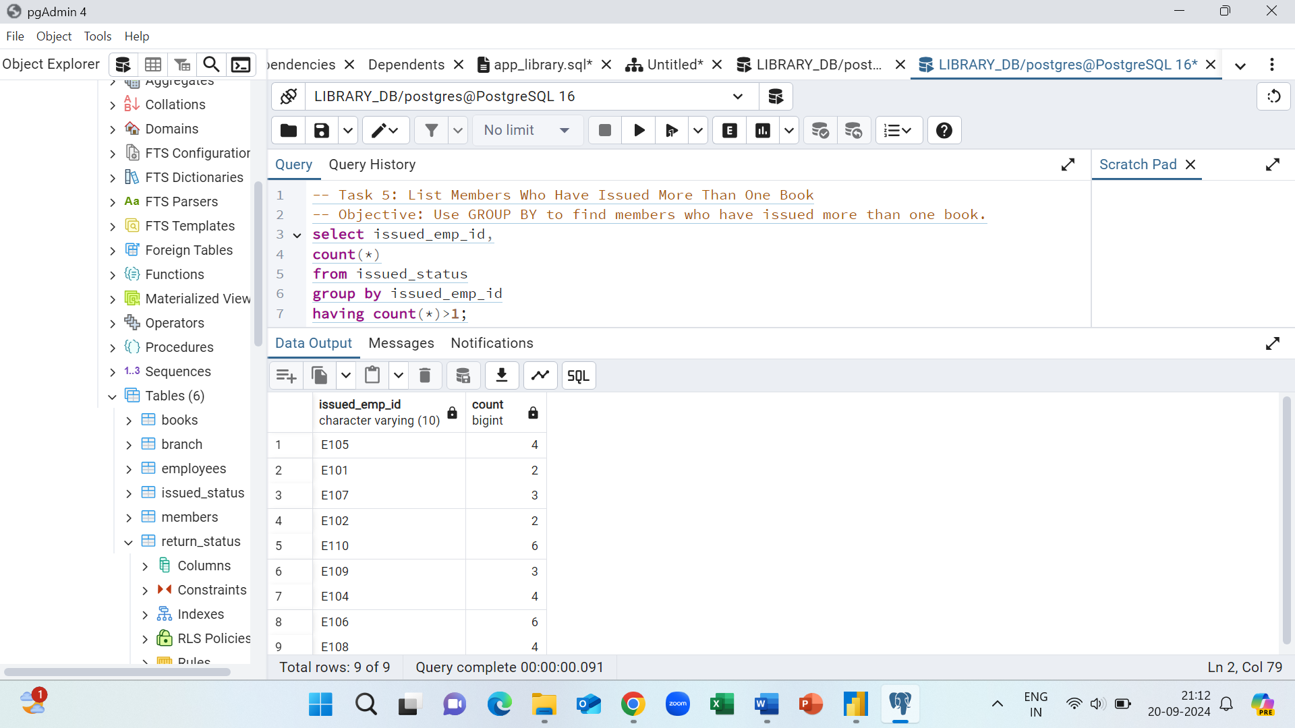
Task 5: List Members Who Have Issued More Than One Book -- Objective: Use GROUP BY to find members who have issued more than one book.

Slide 10
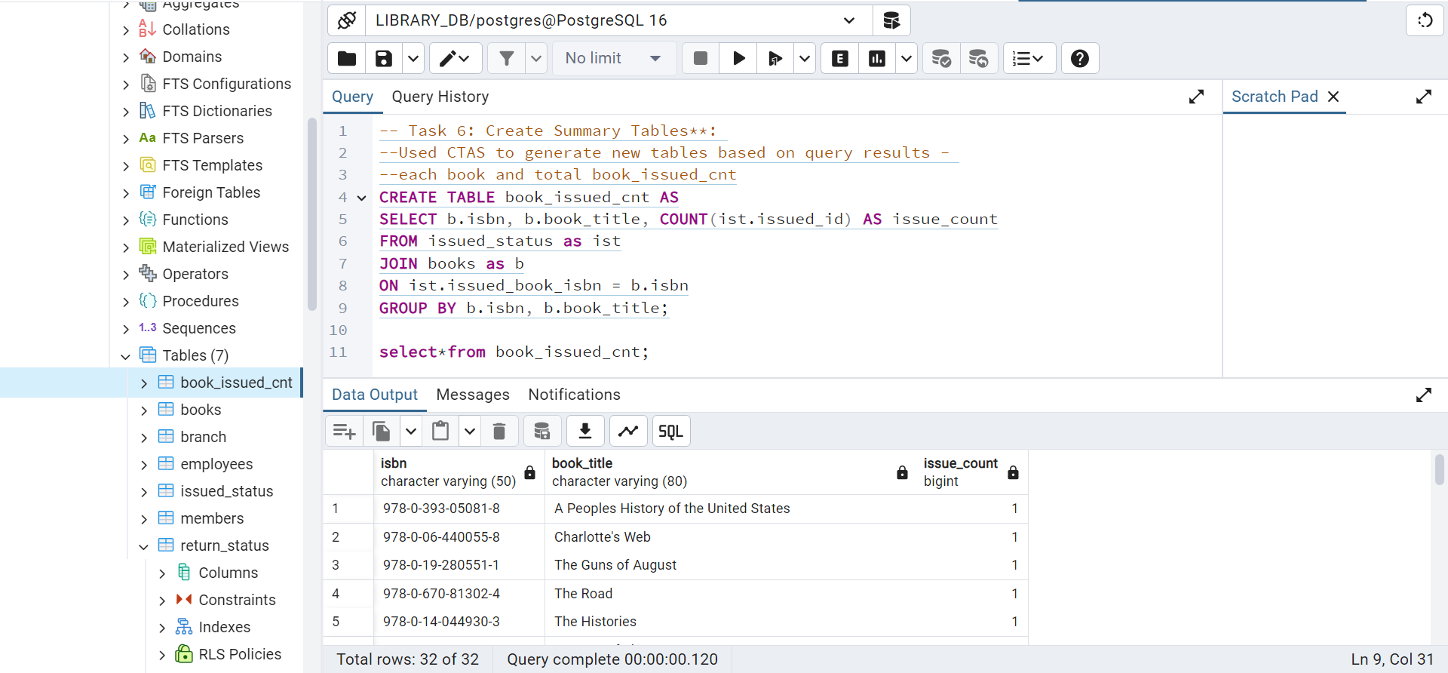
Task 6: Create Summary Tables: Use CTAS to generate new tables based on query results - each book and total book_issued_cnt**

Slide 11
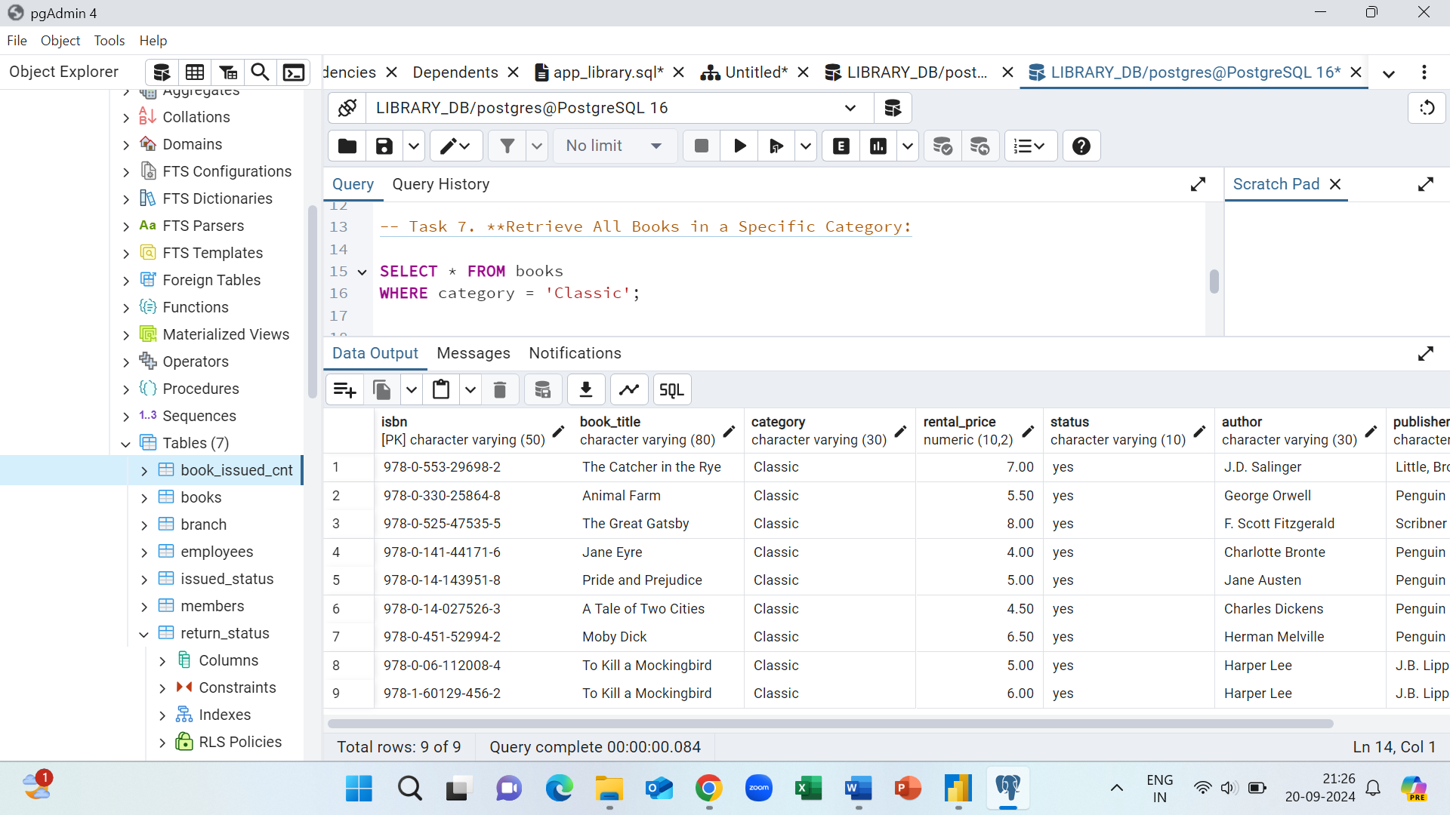
Task 7. Retrieve All Books in a Specific Category: CATEGORY: SPECIFIC

Slide 12
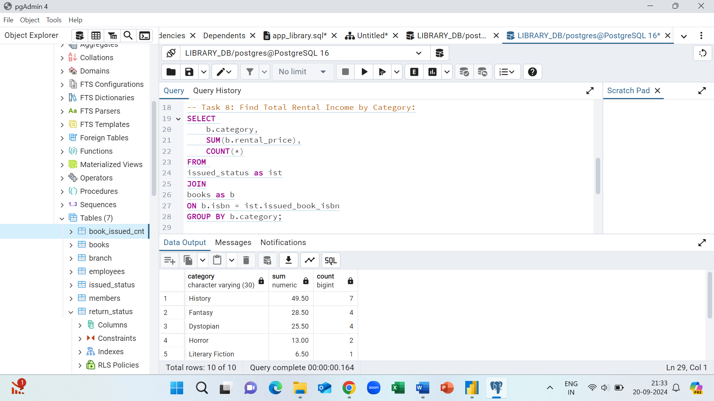
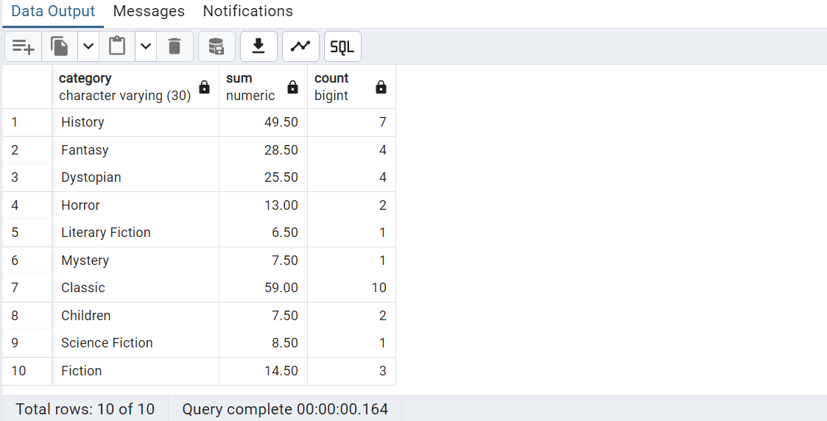
Task 8: Find Total Rental Income by Category:

Slide 13
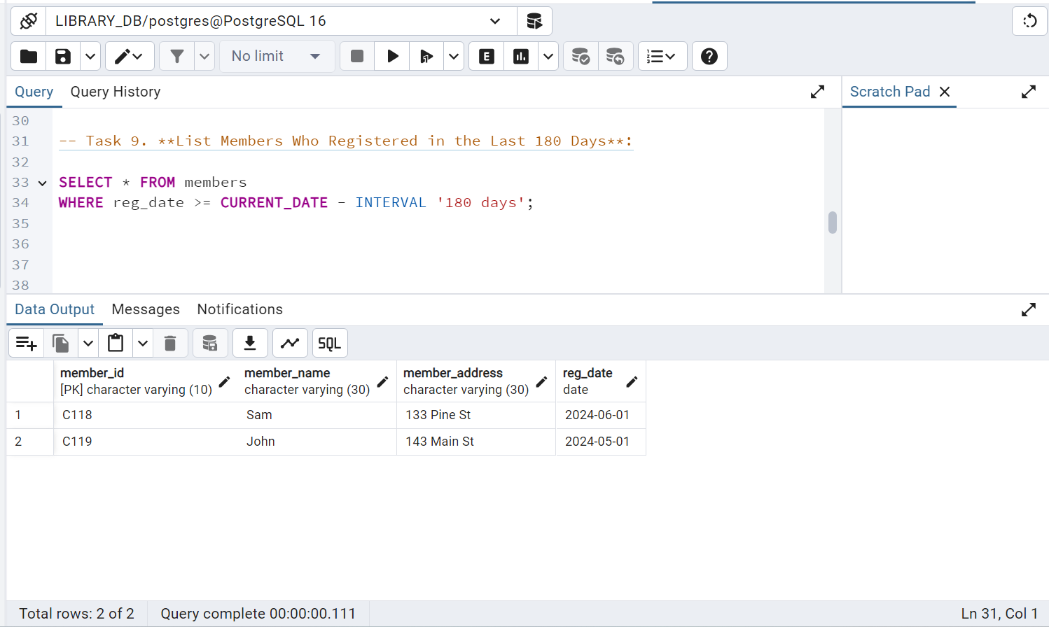
TASK 9: List Members Who Registered in the Last 180 Days:

Slide 14
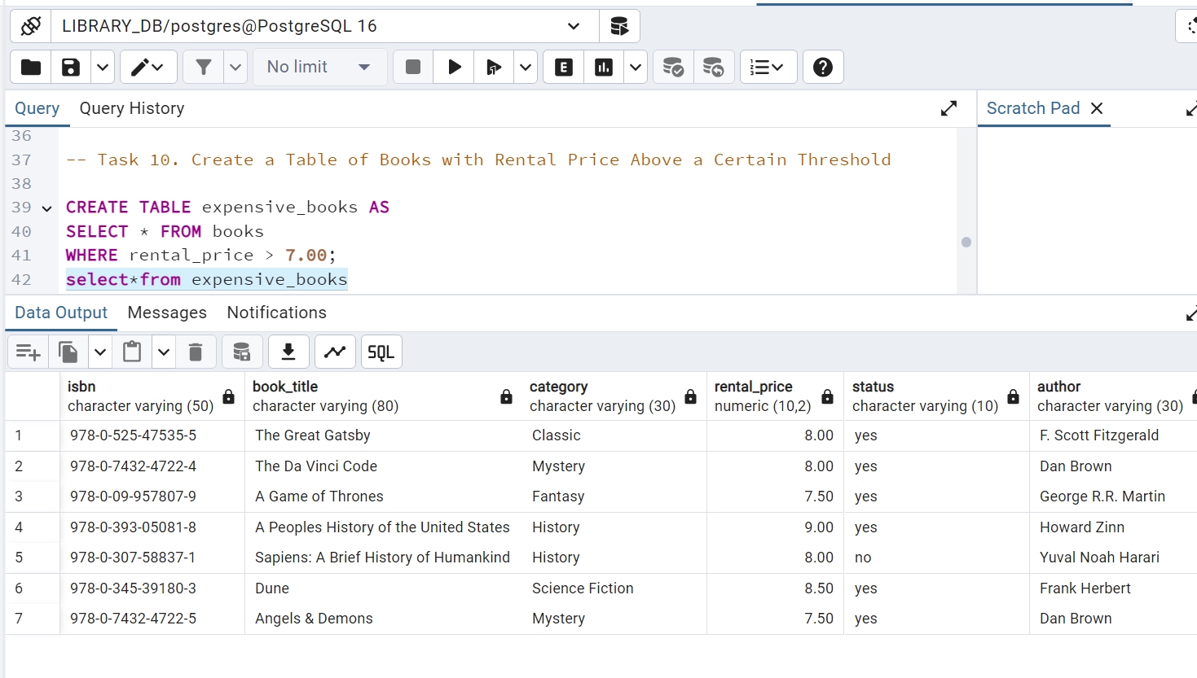
Task 10. Create a Table of Books with Rental Price Above a Certain Threshold: THRESHOLD: 7

Slide 15
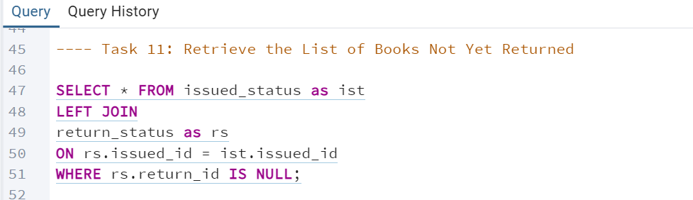
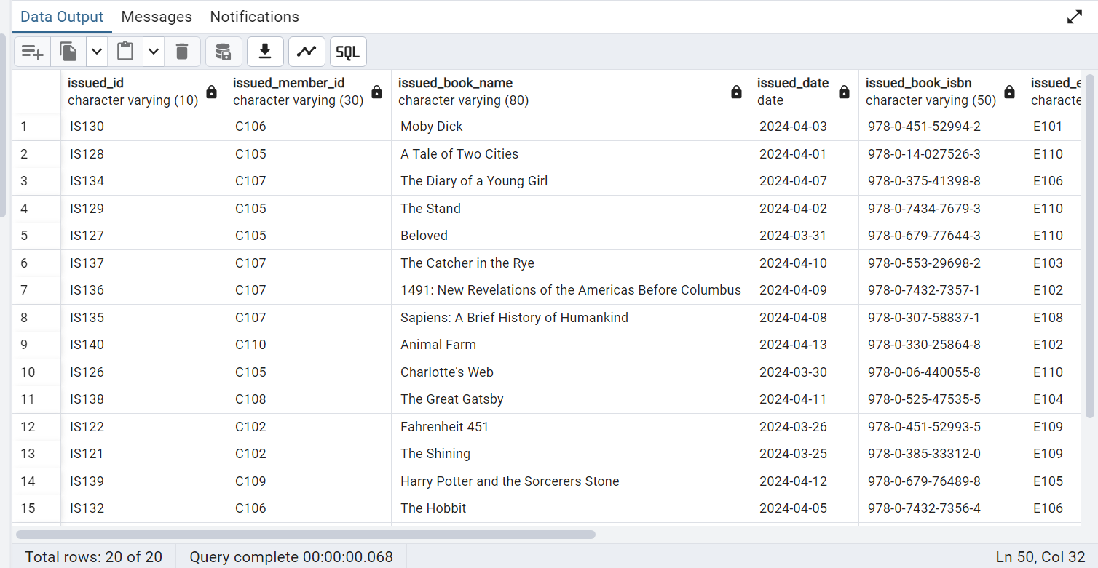
Task 11: Retrieve the List of Books Not Yet Returned

